Slide 1
Evidence-informed change
Informal meeting of EU Education Ministers
Andreas Schleicher
OECD Directorate for Education and Skills
Warsaw, 22 January 2025
Notes:
There are few things that have changed as much in the education sector as what we know about what works in education. When I started at the OECD it was largely unheard of to think of an RCT or experimental study being held in education. Research was often country-focused, exchange was limited, and our understanding of what worked in classrooms hinged mainly upon theory and opinions.

Slide 2
But with a little light….

Slide 3
In the dark, all students, schools and systems look the same…

Slide 4
…but with a little light you can see differences
But with a little light….

Slide 5




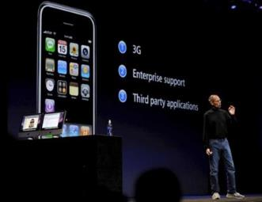
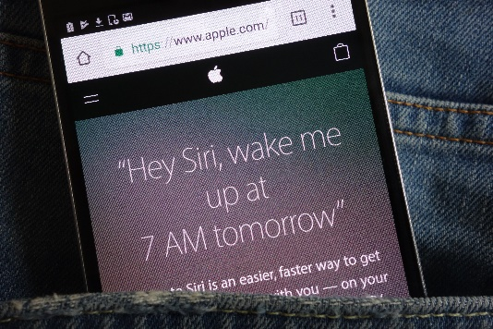

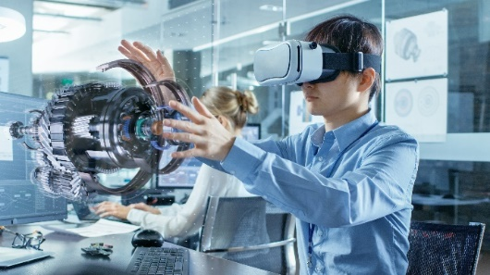

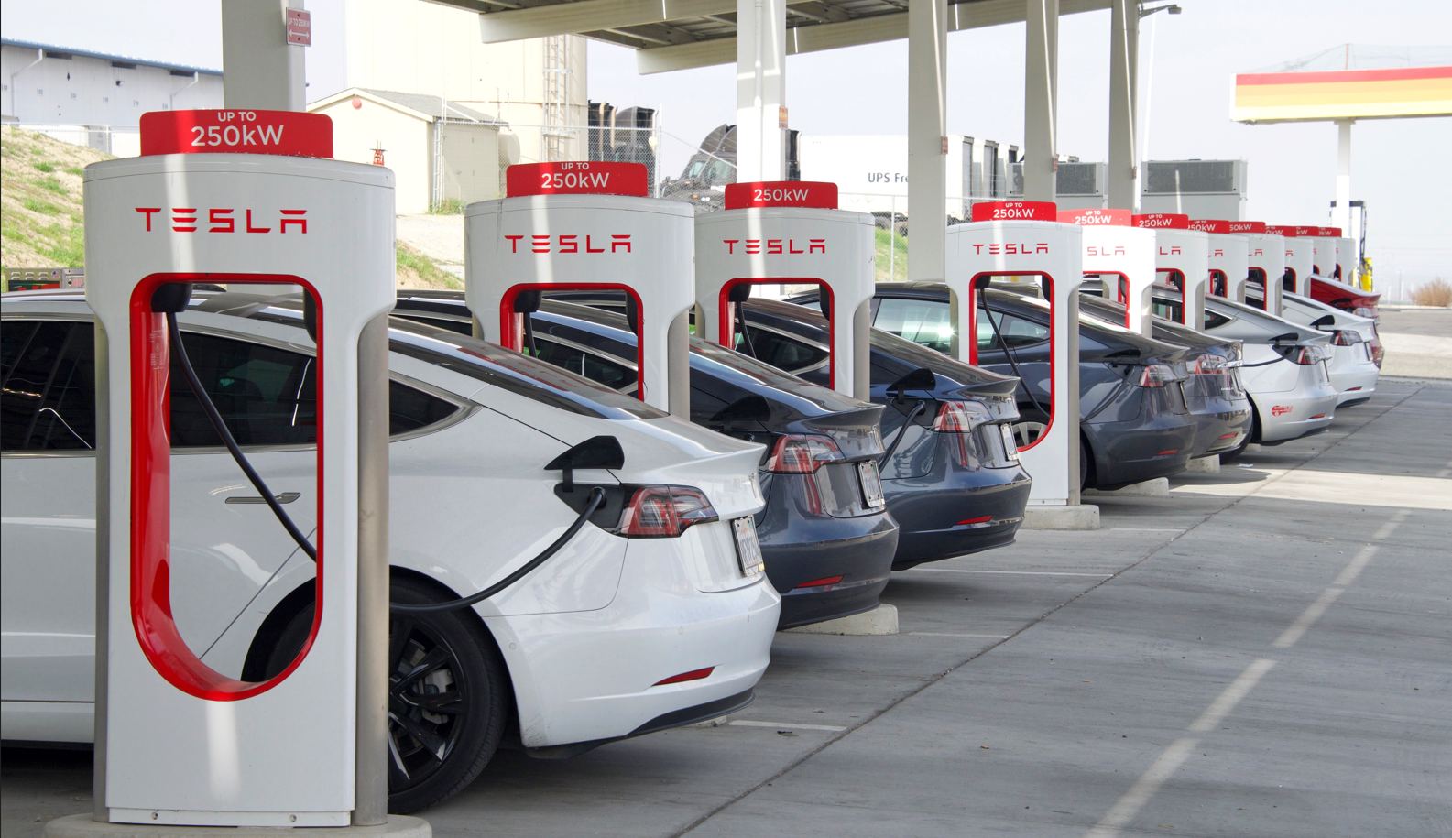







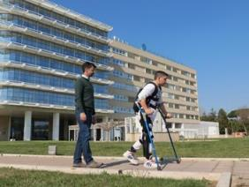



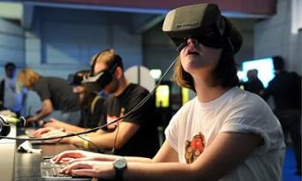




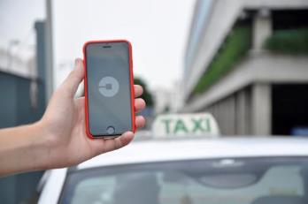



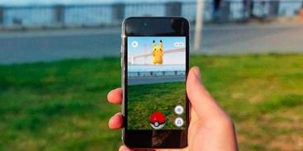
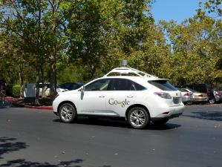






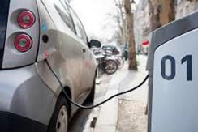
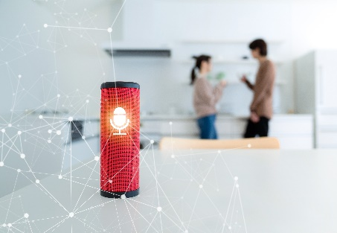


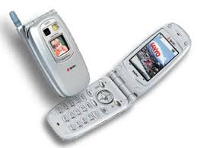
Mathematics (PISA)
Student performance
OECD average
2003
2006
2009
2012
2015
2018
2022
Notes:
We measured mathematics since 2003 in PISA, and you can see how our world has changed since then. The kind of mathematical reasoning that you need today is quite different from what was sufficient in 2003. Some things got a lot easier, as technology has digitised mathematical routines. But other things got harder, if you want to understand climate change or a pandemic you need to have a good understanding of exponentials and be able to distinguish signal from noise and think in terms of probabilities.
The trouble is that across OECD countries, PISA shows the maths skills of 15-year-olds have not progressed and, in fact, since 2018 they dropped sharply by 15 score points. If you think that 20 points is the equivalent of a school year, you get a sense of the magnitude of this decline. And some countries dropped much more: OECD former top performer, Finland, has seen a drop of 60 score points since 2003, the equivalent of three school years.
You might think that’s all because of the pandemic, but you’ll see, that’s just part of the decline.

Slide 6
















Mathematics (PISA)
Student performance
OECD average
74% enrolled
36% enrolled
76% enrolled
55% enrolled
2003
2006
2009
2012
2015
2018
2022
Notes:
Well, the good thing is that there is a group of countries that have bucked this trend and seen good progress over the last decade. These countries show us what is possible.
You can see how Singapore moved from good to great and kept advancing even during the pandemic.
Or look at Macao, Japan and Estonia.
Portugal, Hungary and Israel also saw good progress although they fell back recently
Turkiye saw considerable progress and was, at the same time, able to also get a lot more students enrolled in school
Romania and Moldova have seen some success
At the lower end of the performance spectrum you can see how Qatar achieved remarkable progress, Montenegro also progressed
Peru, Colombia and North Macedonia also advanced
And then Brazil is another of those countries that expanded access and raised quality at the same time.
All this then gets you to the international league tables for PISA which always get a lot of attention.

Slide 7




Social inclusion
Math skills of students
from most advantaged decile
OECD average
Student performance
Math skills of students
from poorest decile
2003
2006
2009
2012
2015
2018
2022
Notes:
Let me bring one more dimension into this picture and that is equity in opportunity.
Take a country from the middle of the league table, like the Slovak Republic, and look at the performance gap between the students from the most disadvantaged, and the wealthiest families, expressed by the 1st and 9th deciles.
That social gap almost spans the world and when you see this you might think poverty is destiny.
But then look at how comparably disadvantaged students in Switzerland have math skills that match an average performer in the Slovak Republic.
And when you look at the most disadvantaged students in Macao, you can see they almost reach the performance of the most privileged students in the Slovak Republic.
That tells us that poverty need not be destiny and that students from all social backgrounds can reach high performance standards in the right conditions. Closing this opportunity gap is the greatest promise of a good education. If you come from a wealthy family, you will always find open doors in life. But if you come from a disadvantaged background, you often just have one single chance in life, finding a great teacher and a great school. If you miss that boat, you often face an uphill struggle.
And the recepy for equity is not rocket science, it is about aligning resources with needs, about attracting the most talented teachers to the most challenging classrooms and about valuing diversity in schools and classrooms.

Slide 8

Combining excellence and equity
Strength of socio-economic gradient and mathematics performance
Figure I.4.2
OECD average: 472 points
OECD average: 15%
Greater socio-economic fairness
Notes:
Here you see a summary of all of this, the green quadrant shows the countries that combine high academic standards with equity in learning opportunities

Slide 9






Isolation of disadvantaged students from high-achieving students
Table II.B1.4.17
  Lower probability for disadvantaged students to attend a school that enrols high-achieving students

Slide 10

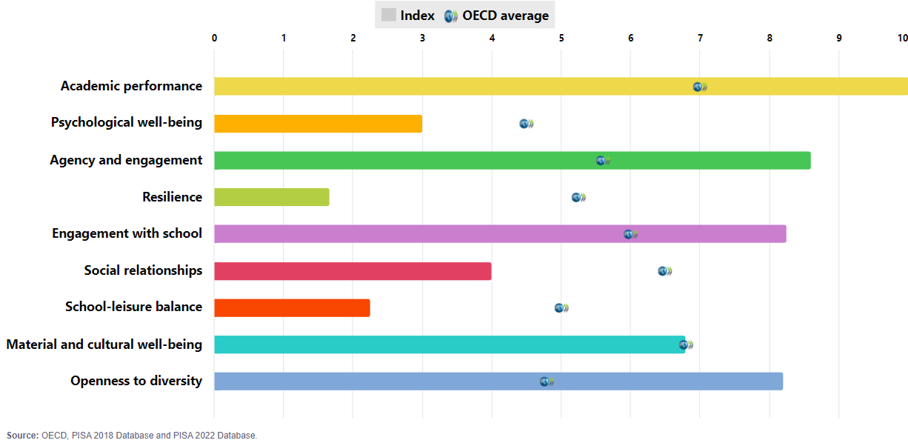
PISA 2022 outcomes: Singapore

Slide 11

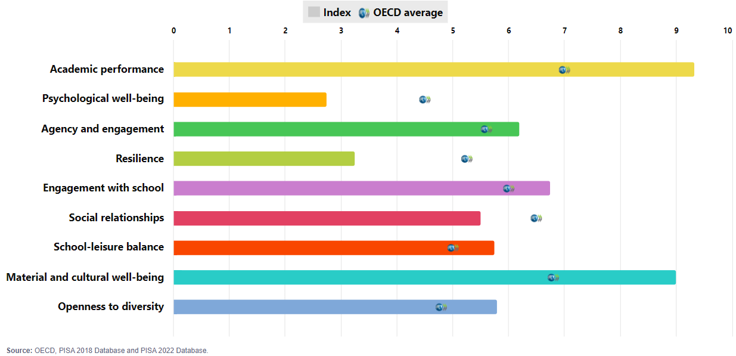
PISA 2022 outcomes: Ireland

Slide 12

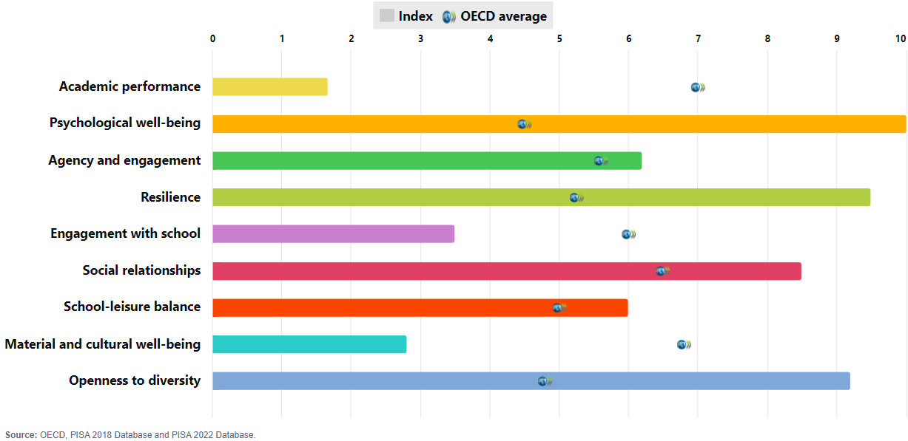
PISA 2022 outcomes: Albania

Slide 13

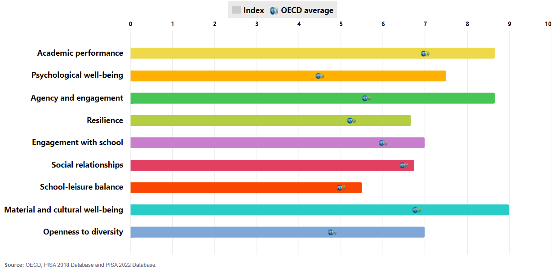
PISA 2022 outcomes: Denmark

Slide 14
Using resources effectively
Money matters up to a point
Notes:
What can we do to improve results?

Slide 15


Money is necessary but not sufficient
Figure I.4.15
OECD average: 472 points
OECD average: USD 102 612
Notes:
There’s a temptation to think this is all about money
But while money matters for countries that invest little, here on the left side, for the countries on the right side, and that includes most OECD countries, the relationship between spending per student and learning outcomes is rather tenuous.
Top performer Singapore, spends roughly the same as Qatar but does much better.
And high performer Vietnam the same as the Philippines and does far better.
So money is necessary, but not sufficient.

Slide 16


Learning time
Hours learning out of school
Hours learning in school
Source: OECD (2023), PISA 2022 Results: Learning During – and From – Disruption. Volume II.
Notes:
[SAME as Slide 4 with European countries only (not restricted to EU)]
But when you look at productivity, learning gains per hour of instruction, you can see that in you can see that in Switzerland, Finland and the Czech Republic students learn a lot in very little time, whereas in Italy students spend a lot of time learning very little.
Keep in mind that learning is always the product of the quantity of learning opportunity and the quality of learning experiences. And those learning experiences depend on nothing more than on the quality of teaching. This in turn hinges on whether teachers use effective pedagogical practices.

Slide 17
Learning time ≠ learning outcomes
Productivity
Hours learning out of school
Hours learning in school
Source: OECD (2023), PISA 2022 Results: Learning During – and From – Disruption. Volume II.
Notes:
Multi-disciplinary teams

Slide 18


Salaries show little relationship to the attractiveness of the profession
Ratio of salaries of teachers with the most prevalent qualification at the time of entry in public institutions relative to the earnings of full-time, full-year workers aged 25-64 with similar educational attainment
Parity
Source: OECD (2024), Education at a Glance 2024: OECD Indicators, OECD Publishing, Paris, https://doi.org/10.1787/c00cad36-en.
Note: The number in square brackets refers to the average number of years to progress from the starting salary to the top of the salary scale. 1. Combination of different salary scales for the same ISCED qualification requirement. 2. Weighted average of the statutory salaries across different subnational entities. 3. Starting salary is relative to the earnings of workers who have attained a bachelor's degree or equivalent (ISCED 6). Salaries after 15 years of experience and at the top of the salary scale are relative to the earnings of workers with a master's degree or equivalent (ISCED 7) or higher attainment. 4. In practice, many teachers obtain higher tertiary degrees during their service and are placed in a higher salary range. Countries and economies and other participants are ranked in descending order of relative starting salaries.
Figure 1.6. Lower secondary teachers’ statutory salaries tend to be less competitive (2023)
Notes:
While salaries tend to be uncompetitive in many systems, and they remain an important factor in teacher attraction, other dimensions matter too.

Slide 19







But there is more to the story
Relative salaries of teachers and teachers’ job satisfaction
Relative Teacher salaries
% of teachers who agree that the advantages of being a teacher clearly outweigh the disadvantages
Notes:
Professional development and collaboration are key to job satisfaction and retention. Teachers who engage in joint activities with colleagues or continuous professional learning report higher levels of self-efficacy and motivation. Systems must create opportunities for teachers to grow, both intellectually and professionally. Systems where teachers feel valued, such as Singapore an d Finland, tend to report higher satisfaction levels, even if salaries are not the highest.

Slide 20



Where teachers feel their work is valued by society

Slide 21
Effective teacher professional development improves job satisfaction, important for attracting candidates and retaining teachers
Change in job satisfaction when participating in effective professional development activities in the 12 months prior to the survey​
Higher
Job satisfaction
No change
(ISCED 2, 2018)

Slide 22
Teachers and teaching
Are some students being let down?
Notes:
But lets get back to teachers. During the pandemic, it became abundantly clear that learning is not a transactional business but a social and relational process.

Slide 23




Teacher support
Figure II.2.10
Percentage of students who agreed or strongly agreed with the following statements about the time when their school building was closed because of COVID-19; based on students' reports
Notes:
So we asked students about their experiences during the pandemic.
In Vietnam, almost 9 out of 10 students said their teachers were available when they needed help, and just 30% that they felt lonely.
Very different in Japan, where just 40% felt they could rely on their teachers and an equal share felt lonely.
And on average across countries, almost one third of students didn’t feel their teachers were available when they needed them. That’s a really troubling result.

Slide 24
Students learn best from teachers they love
Remote learning, mathematics performance and confidence in self-directed learning
Figure II.2.12
Change in the index of confidence in students' capacity for self-directed learning/in mathematics performance, when students agreed or disagreed with the following statements about the time when their school building was closed because of COVID-19; OECD average
Students are more confident (Change in the index of confidence in capacity for self-directed learning)
Notes:
What you can see here is that students who felt that their teachers were available when they needed help during the pandemic, were more confident in learning on their own.
And where students felt their teachers were available they also scored roughly a school year better. When we looked more closely into that, we even found that countries where teacher support improved during these last years were generally also the ones where mathematics performance improved.

Slide 25
Teachers play a key role in the level of student anxiety
Figure V.4.7
Change in mathematics anxiety when students agreeing or strongly agreeing with the following statements; OECD average
Change in mathematics anxiety

Slide 26
Revolutionising learning?
Unlocking the potential of the digital world
Notes:
You have just seen how a lack of digital resources can mean poorer learning outcomes, let’s look at this in some more detail.

Slide 27


Time spent at school in regular lessons and on digital devices
Figure II.5.15
Time spent per day by students (in hours)
Devices / leisure at school
Devices / learning at school
Notes:
Here you see the time that students spent using digital devices for learning at school, in blue, and the time that students use digital devices for leisure at school, in green.
When you compare that with the hours students spent in regular lessons, that’s the dark blue diamond here, you see that the use of technology covers now much of the school day. For students the digital world has become the real world.
Students in Ukraine students spend more time online for school than in school, and that’s of course because so many schools are still closed because of the war
Guatemala shows a similar situation, though for different reasons.
The question is, of course, whether spending time online is a good thing or a bad thing.

Slide 28
Time spent on digital devices at school and mathematics performance
Figure II.5.14
Based on students' reports; OECD average
Technology used for learning in school
Technology used for leisure at school
Time spent on digital devices at school per day
Notes:
And the answer differs depending on how technology is used.
When technology is used for learning, the relationship between the hours of technology use and math performance is largely flat.
But students use their smartphones for leisure in school, you can see steeply declining learning outcomes. And that negative relationship between smartphone use and learning, but also well-being, is pretty universal.

Slide 29
Digital devices, distraction and school policies
Figure II.5.9
Change in the likelihood of students becoming distracted by using digital devices in mathematics lessons when students reported that they use their smartphone at school and school principals reported the school's policy on smartphone use; OECD average
Odds ratio
Frequency of use of digital devices
in mathematics lessons
School policies for the use of digital devices
Notes:
And it’s not so surprising, when students used their smartphone at school in most lessons, they were much more likely to be distracted.
So what can we do about this? We didn’t find much of a difference in students being distracted when schools had some written policy or when teachers negotiated rules for smartphone use with their students. Students pretty much ignore what teachers and school leaders say. The only thing that is clearly linked to less distractions was a ban of smartphones at school, as indicated here by the red bar.

Slide 30
What do we know about evidence use in education?

Slide 31
Key conditions for an evidence use culture are lacking
Percentage of respondent systems agreeing or strongly agreeing with the given statement on education research (2021)
Source: OECD (2023), Who really cares about using education research in policy and practice?
Notes:
Good news: Overall, ministries of education think there is a high level of motivation to use research among both policy makers and practitioners. It is particularly encouraging that most systems reported that using education research is important for both policy makers and practitioners.
The extent of willingness to use research can make the difference between low- and high-quality use, as working with evidence requires the disposition to be open to a range of interpretations. However, some systems did not agree that they were also willing to use research to challenge preconceived notions.
Despite the importance attached to trusting relationships when it comes to engaging with research, levels of trust are low according to the survey responses. Good relationships are an important way of encouraging a shared understanding of research, promoting the production of relevant research and ensuring that there are realistic expectations for its use.
Intermediaries could play a key role in building trust in research and between researchers and users.

Slide 32
What does evidence mobilisation encompass?
Creating incentives and infrastructure
Establishing mechanisms
Strategic leadership and coordination
SYSTEM
Building relationships
Facilitating quality interactions
Building skills and capacity
RELATIONAL
Disseminating and communicating research
Facilitating access to research
Linking research production to policy/practice needs
LINEAR
Based on:
Best, A. and Holmes, B. (2011) and Boaz (2021)
Notes:
We often use the term knowledge mobilisation to refer to efforts that aim to facilitate the use of education research in policy and practice.
This encompasses a range of different strategies.
Around 20 years ago, the focus was on linear processes: disseminating research findings in accessible formats and facilitating access to them. However, it became very quickly clear that this in itself is not enough to ensure the use of research.
Connecting people – researchers, policy makers and practitioners – through partnerships and networks is key. Relational approaches also include building their skills and capacity is necessary to generate quality interactions among them and build a shared understanding of what research evidence is and how it can be used well.
However, this is still not enough. Teachers’, schools’, researchers’ and policy makers’ opportunities and motivations are influenced by the system. System-level mechanisms and incentives are necessary to support their work.
Today we know that effectively bridging the gap between research, practice and policy requires that all these strategies are applied in a coordinated way.
The European Union can play a key role in ensuring system-level approaches to evidence use.

Slide 33
Mechanisms of and barriers to facilitating research use
Linear mechanisms and barriers
Source: OECD (2022), Who cares about using education research in policy and practice?
Notes:
This data comes from the OECD’s Strengthening the Impact of Education Research project’s policy survey. Responses reflect 37 ministries’ of education perspectives representing 29 countries.
Good news is that the majority of systems provide funding for research on specific topics. However, much fewer systems identify policy and practice needs and research gaps systematically. This may lead to a misalignment of research production and needs. Equally, around 40% of systems do not have the most basic linear mechanism: user-friendly access to research syntheses.
These gaps are reflected in the barriers systems reported: low accessibility and lack of relevant research remain a major barrier in about half of the systems.

Slide 34
Mechanisms of and barriers to facilitating research use
Relational mechanisms and barriers
Source: OECD (2022), Who cares about using education research in policy and practice?
Notes:
There has been a strong focus on relational approaches, particularly in practice: 86% of systems have projects that facilitate interactions between research and practice.
The EU’s education programmes, like Erasmus+ is a great example of such projects.
However, these will only be effective in bridging the research-practice gap, if they are coupled with appropriate skills and capacity building. These are still lacking in many systems.
Again, this is confirmed when we look at the reported barriers: low levels of skills to using research seems to be a key issue.

Slide 35
Mechanisms of and barriers to facilitating research use
System mechanisms and barriers
Source: OECD (2022), Who cares about using education research in policy and practice?
Notes:
Clearly, system-level mechanisms are the ones that are lacking! Only a handful of systems reported that they have a system-wide strategy to facilitate the use of research.
Again the corresponding barriers confirm this:
Lack of time to access and engage with research suggest that there are no appropriate incentives to do so.
Interestingly, while countries reported various mechanisms to facilitate the use of research; the lack of such mechanisms is still a major barrier. This suggests that these mechanisms are not (yet) effective enough or lack coordination and alignment.
Again, an EU agenda could help move this forward at the system level.

Slide 36
Learning opportunities for teachers are lacking
Percentage of systems reporting skills as reported or mostly covered by ITE and CPD (2021)
Initial Teacher Education
Continuous Professional Devt.
Source: OECD (2023), Who really cares about using education research in policy and practice?
Notes:
Only around one-third of respondent ministries reported that training future teachers to understand, interpret and apply research findings is required in all ITE programmes, and less so in CPD.
Collaborating with others in research production and use is even less covered in teacher training.
It is worth noting that systems reporting skills as required or mostly covered by ITE tended to report that this was the case for all the skills. This suggests that when systems do integrate research engagement to teacher training, they tend to do it quite comprehensively. However, this is still rare.

Slide 37
Thank you
Andreas.Schleicher@oecd.org

