Slide 1
kor

Slide 2
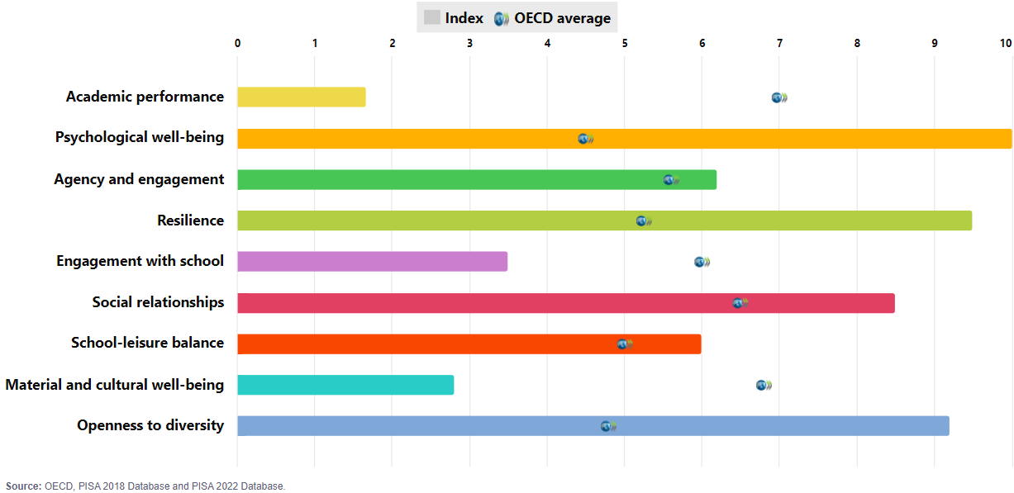
PISA 2022 outcomes: Albania

Slide 3
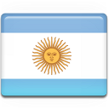
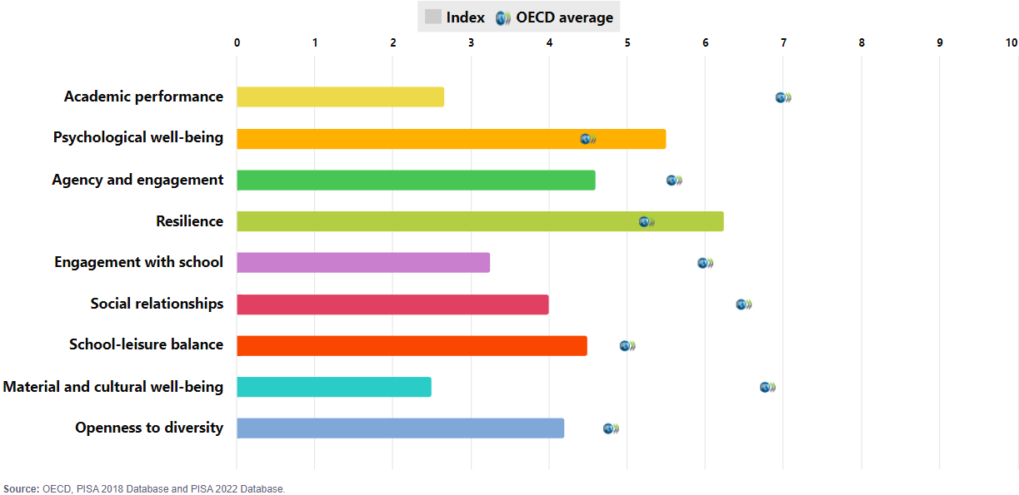
PISA 2022 outcomes: Argentina

Slide 4
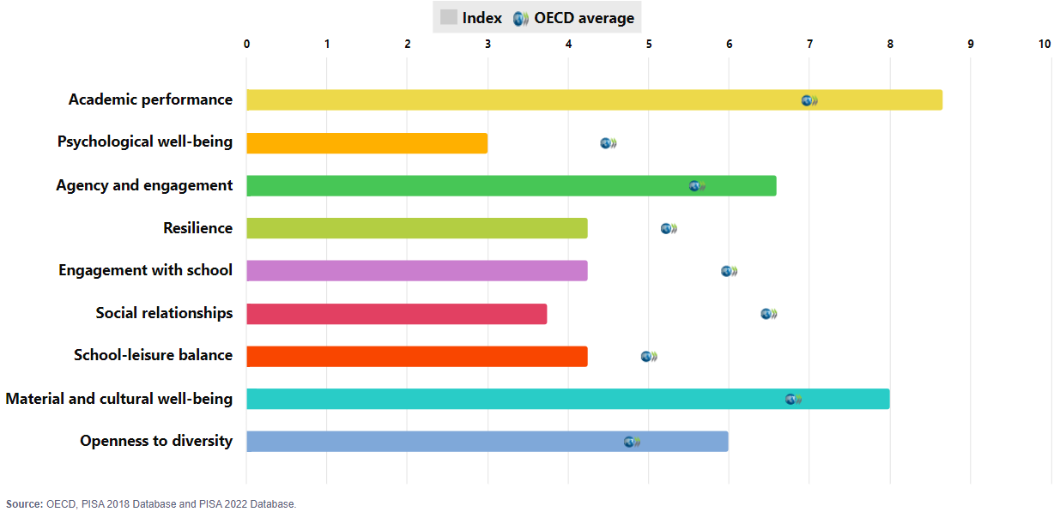
PISA 2022 outcomes: Australia

Slide 5
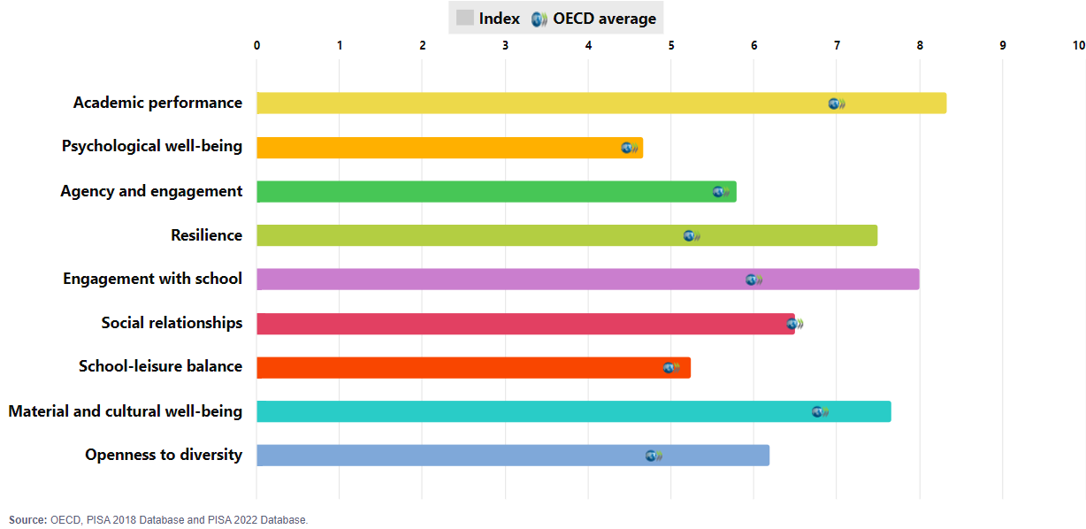
PISA 2022 outcomes: Austria

Slide 6
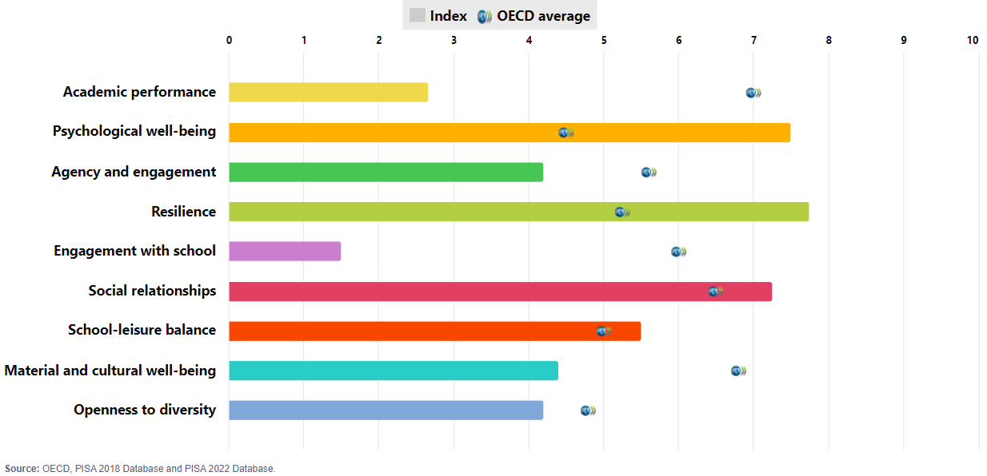
PISA 2022 outcomes: Baku (Azerbaijan)

Slide 7
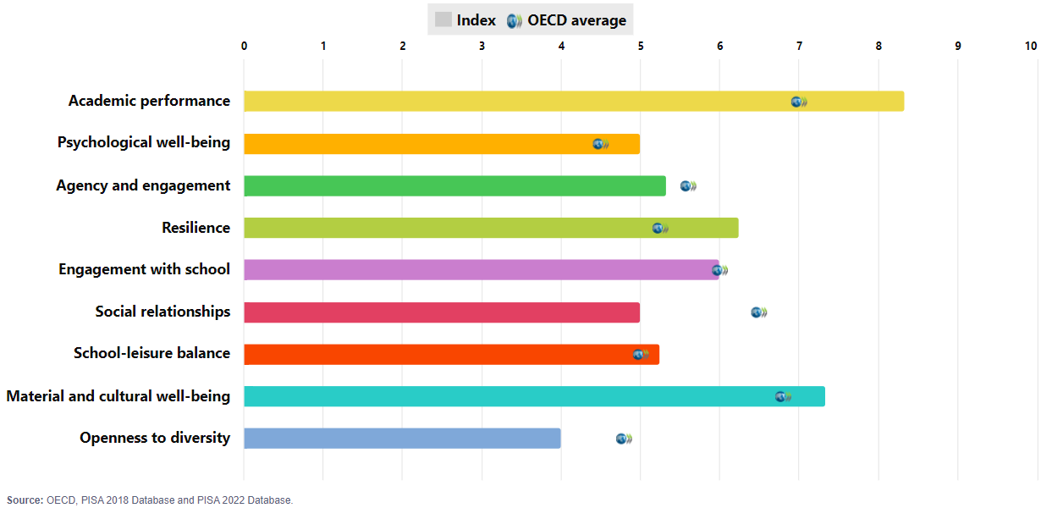
PISA 2022 outcomes: Belgium

Slide 8
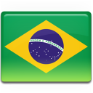
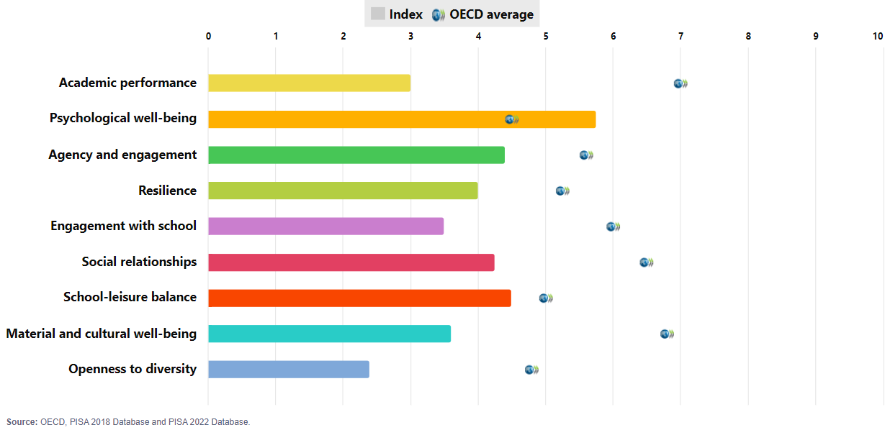
PISA 2022 outcomes: Brazil

Slide 9
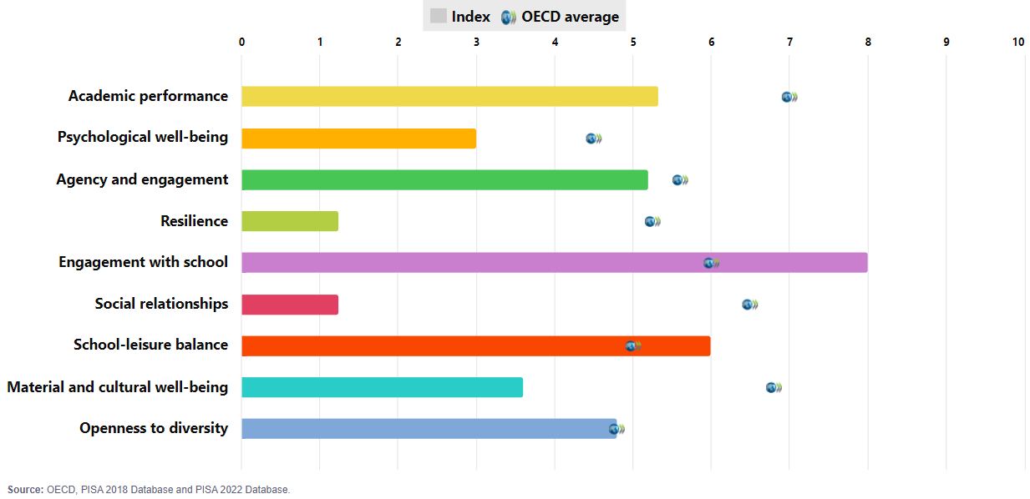
PISA 2022 outcomes: Brunei Darussalam

Slide 10
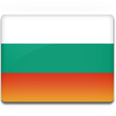
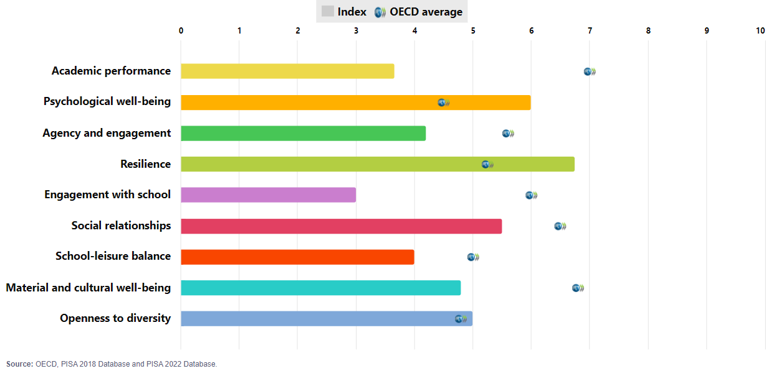
PISA 2022 outcomes: Bulgaria

Slide 11
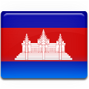
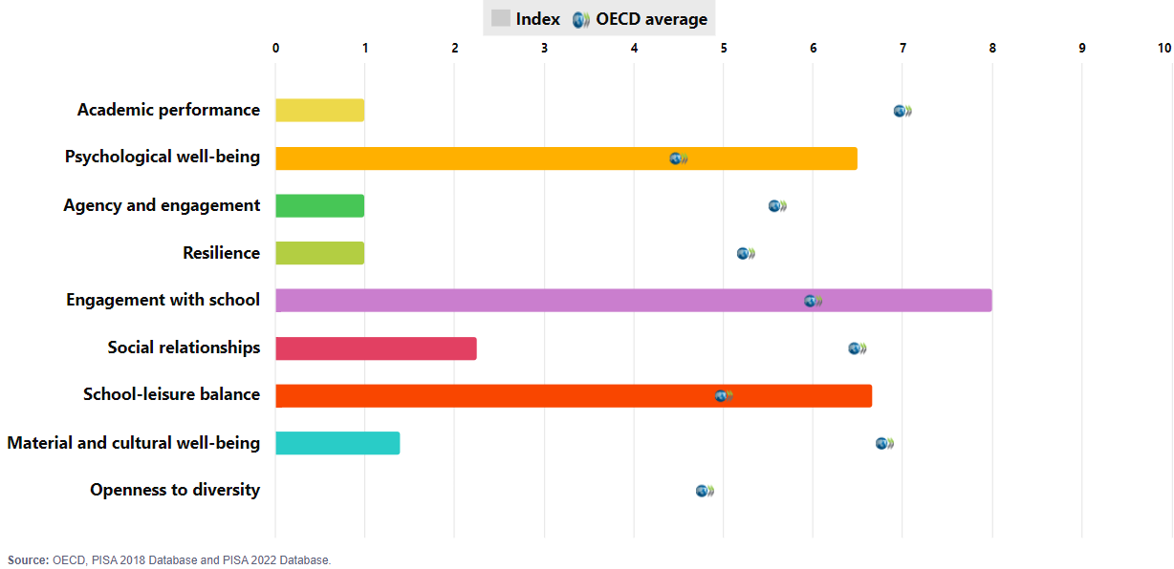
PISA 2022 outcomes: Cambodia

Slide 12
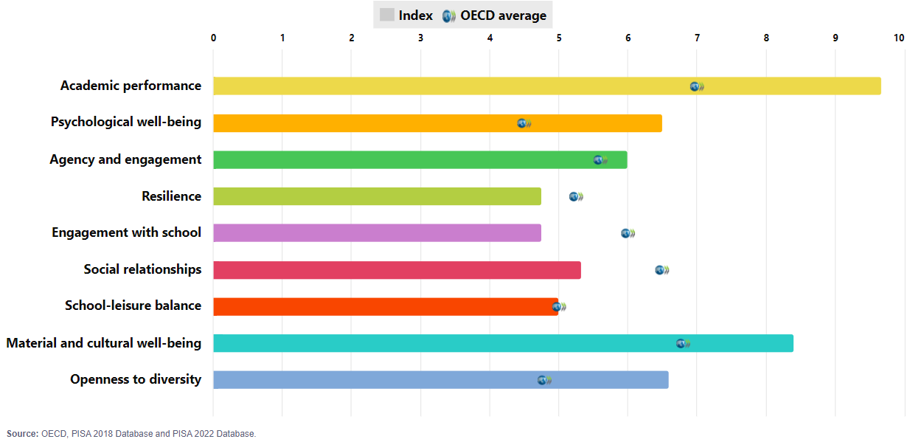
PISA 2022 outcomes: Canada

Slide 13
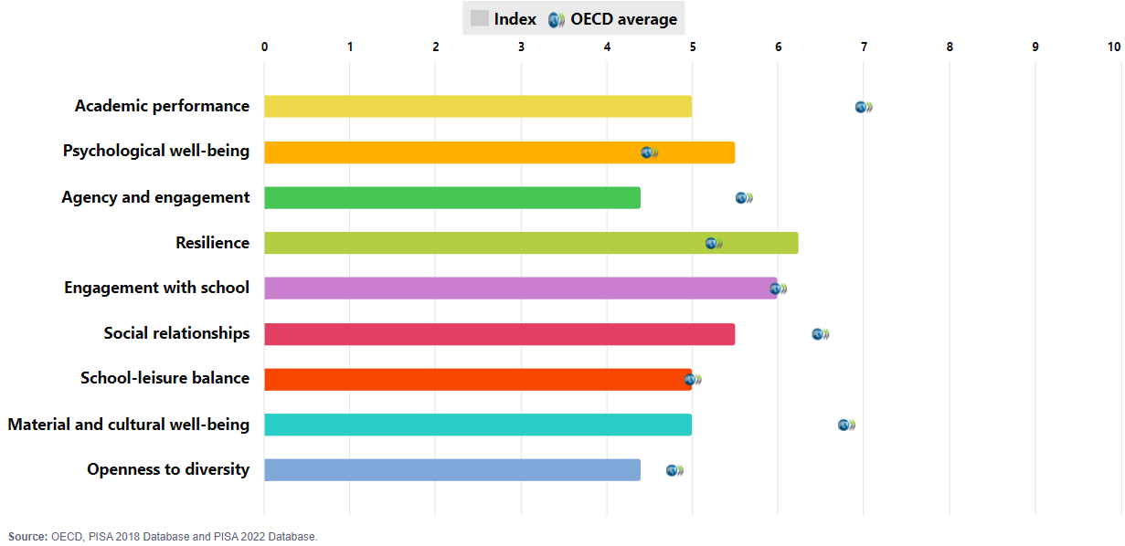
PISA 2022 outcomes: Chile

Slide 14
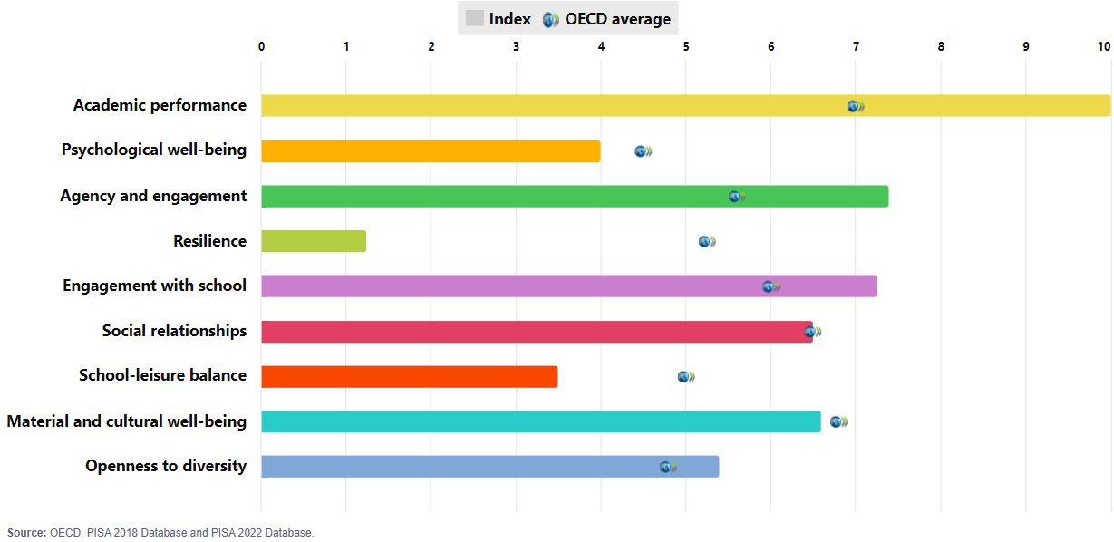
PISA 2022 outcomes: Chinese Taipei

Slide 15
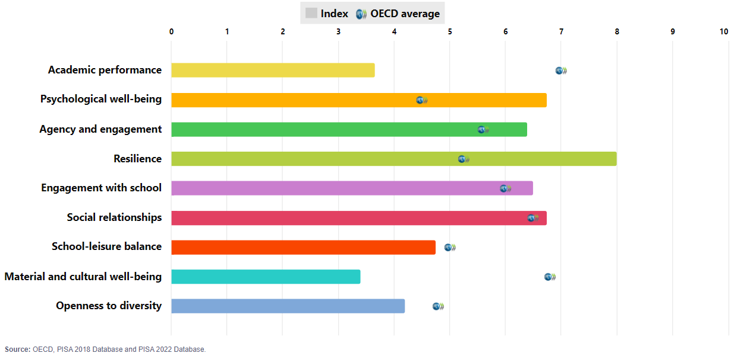
PISA 2022 outcomes: Colombia

Slide 16
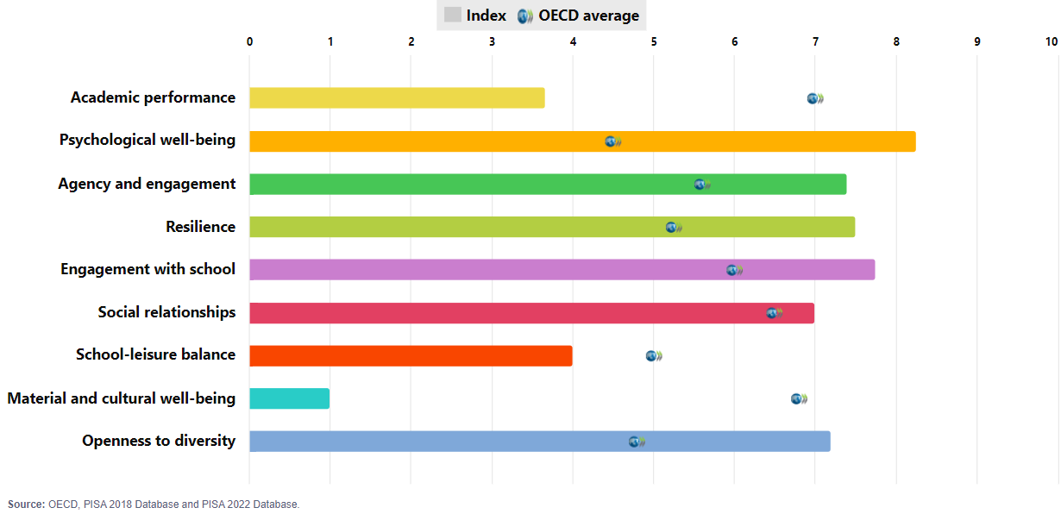
PISA 2022 outcomes: Costa Rica

Slide 17
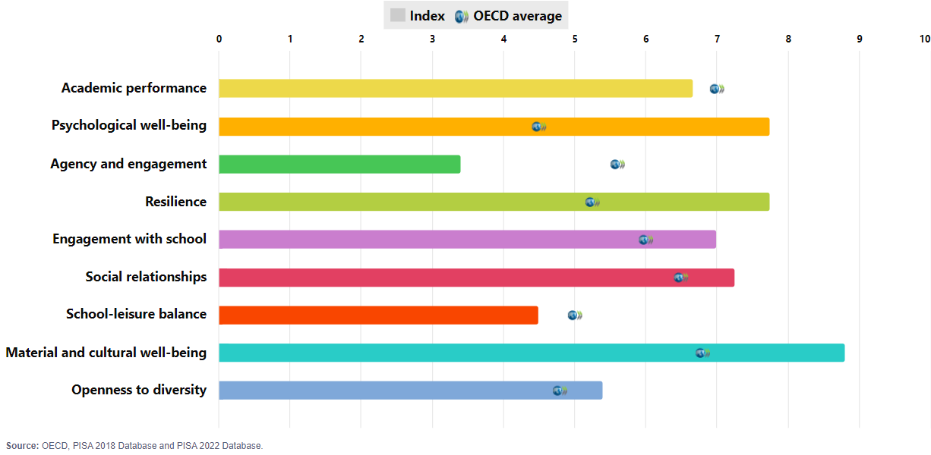
PISA 2022 outcomes: Croatia

Slide 18
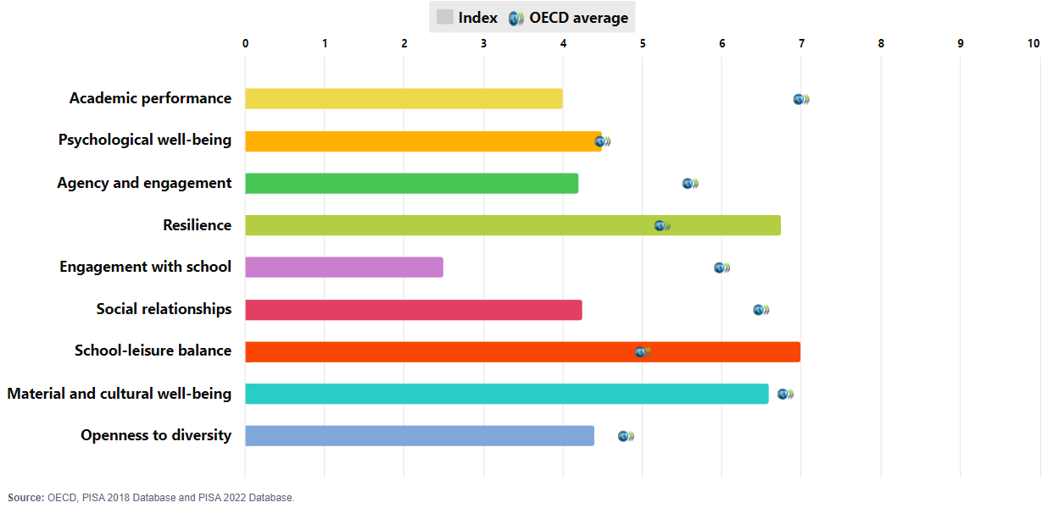
PISA 2022 outcomes: Cyprus

Slide 19
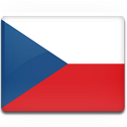
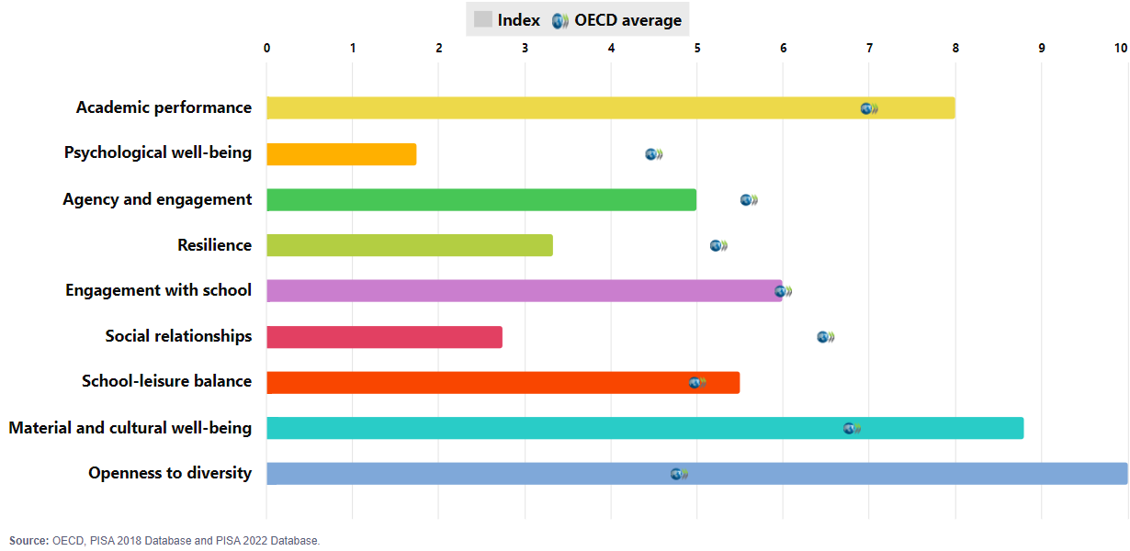
PISA 2022 outcomes: Czechia

Slide 20
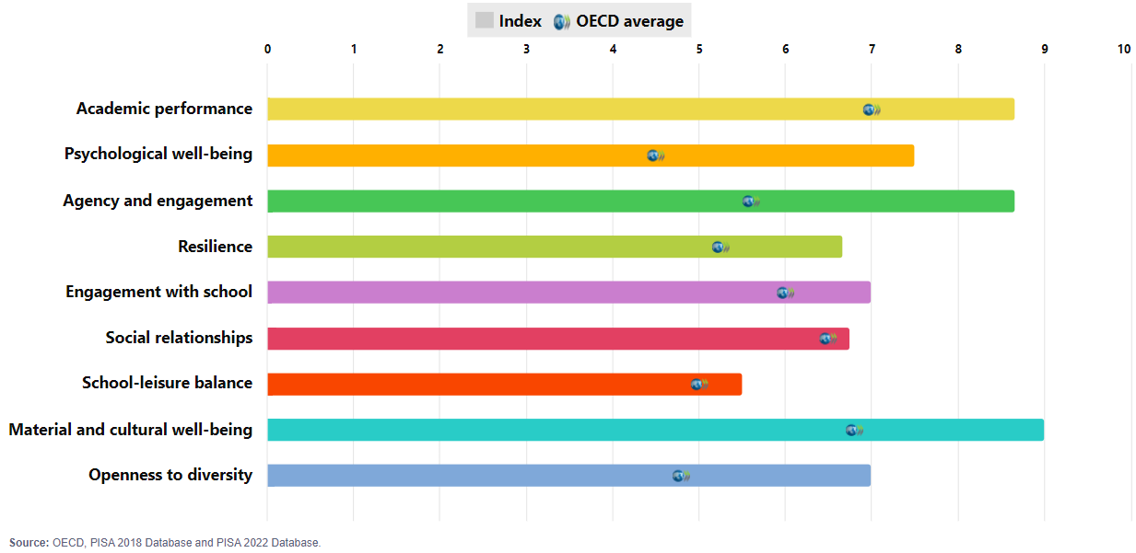
PISA 2022 outcomes: Denmark

Slide 21
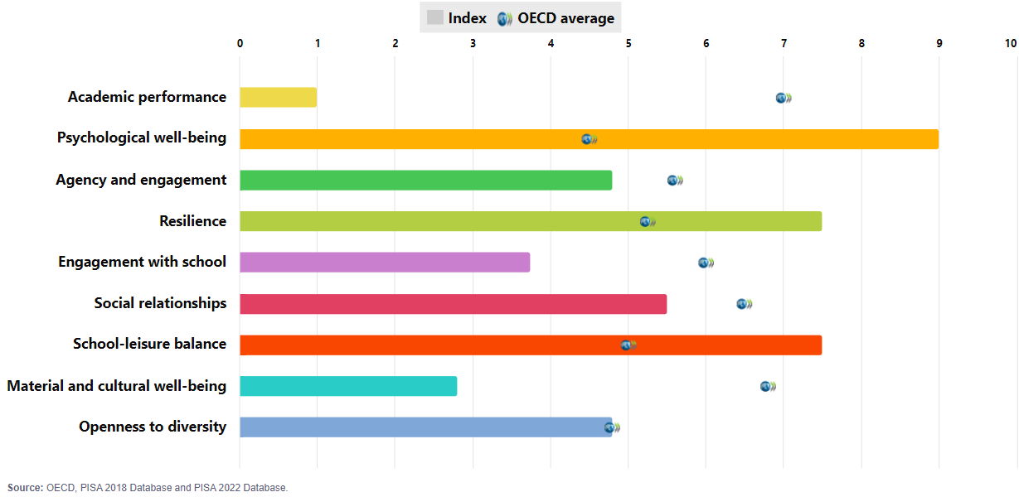
PISA 2022 outcomes: Dominican Republic

Slide 22
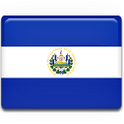
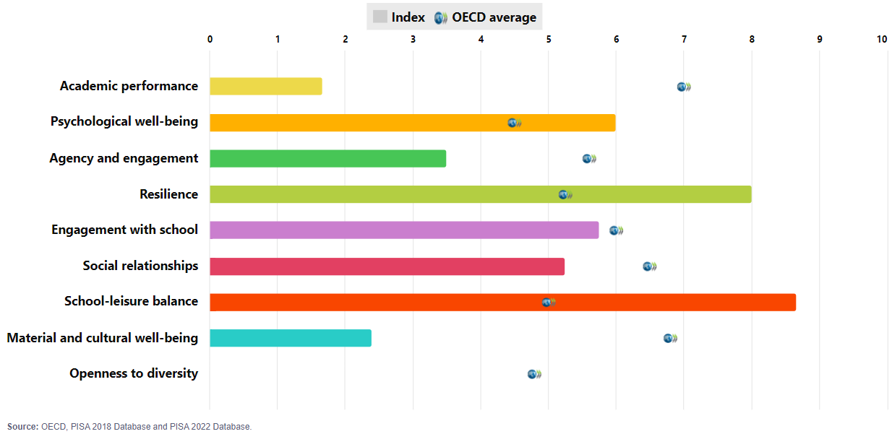
PISA 2022 outcomes: El Salvador

Slide 23
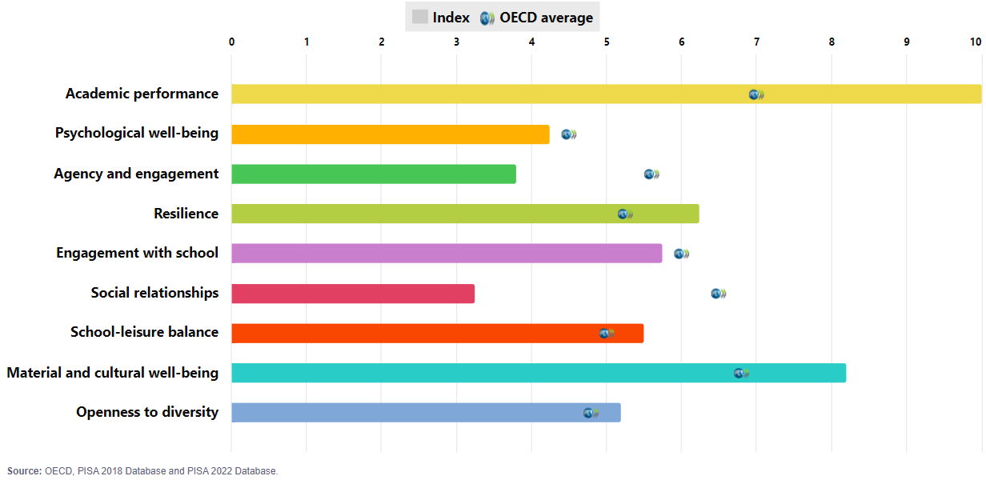
PISA 2022 outcomes: Estonia

Slide 24
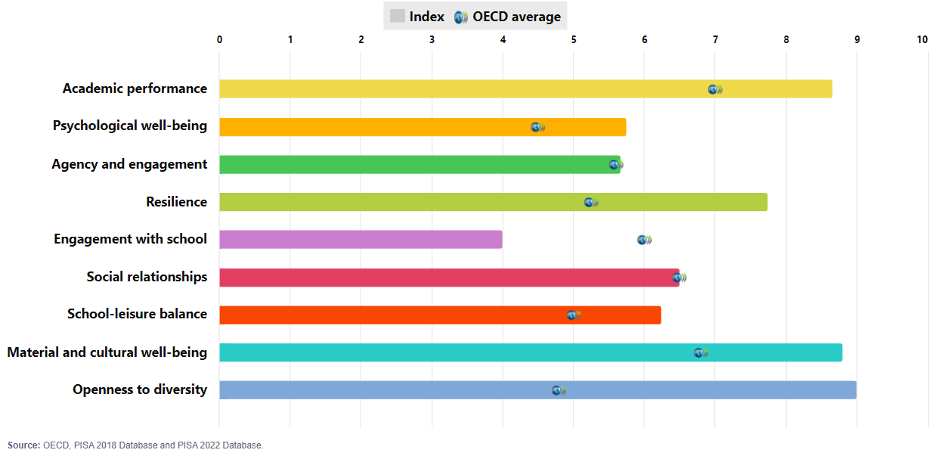
PISA 2022 outcomes: Finland

Slide 25
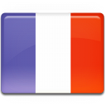
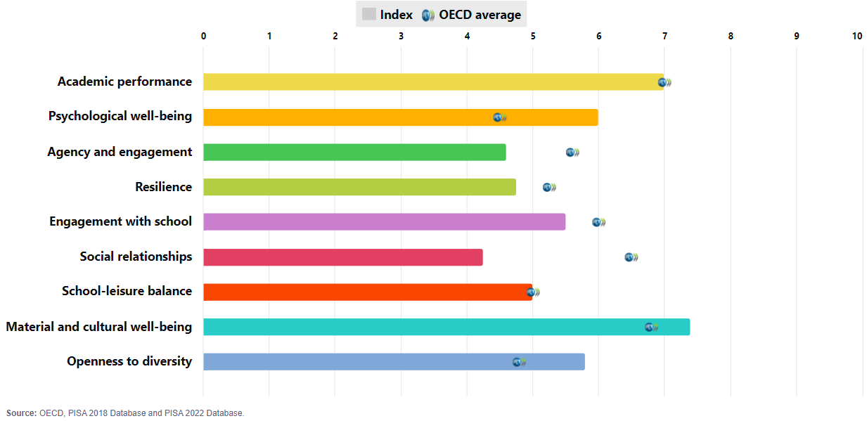
PISA 2022 outcomes: France

Slide 26
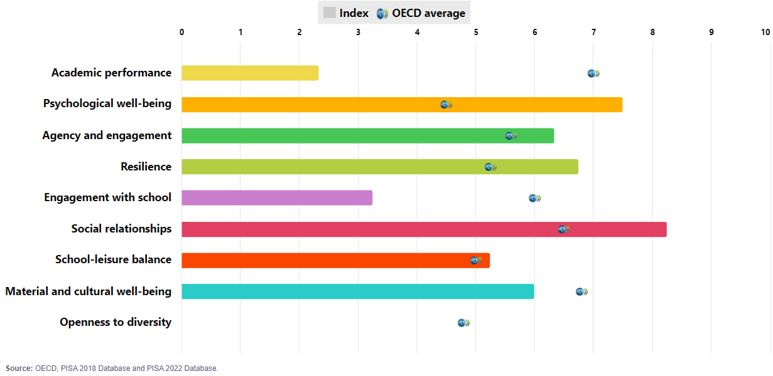
PISA 2022 outcomes: Georgia

Slide 27
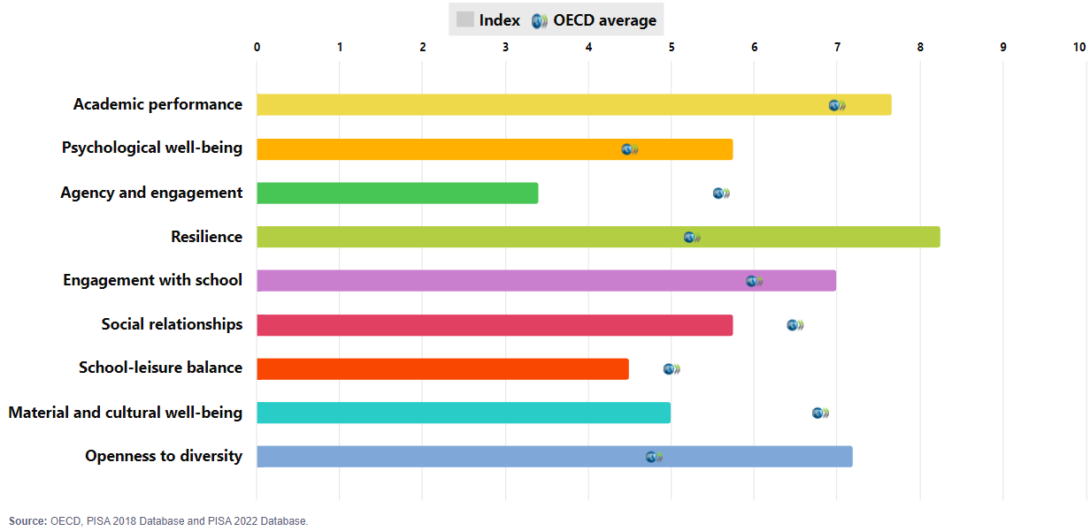
PISA 2022 outcomes: Germany

Slide 28
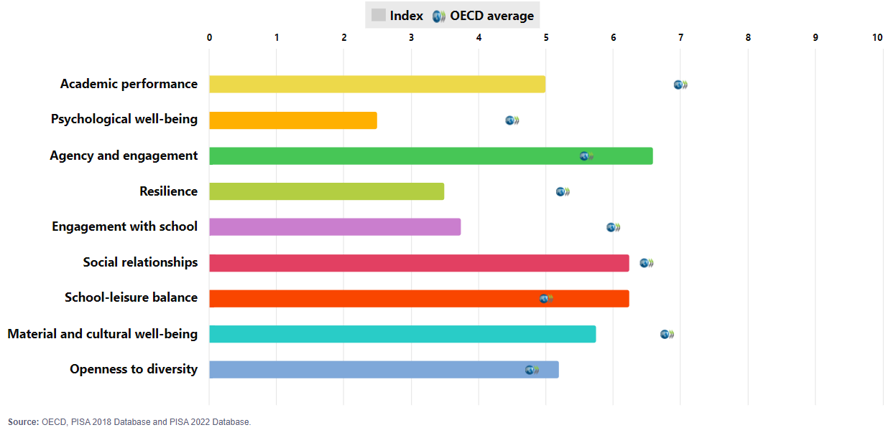
PISA 2022 outcomes: Greece

Slide 29
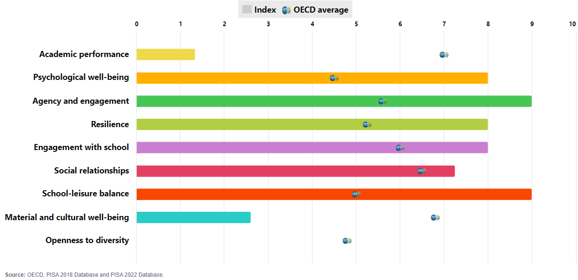
PISA 2022 outcomes: Guatemala

Slide 30
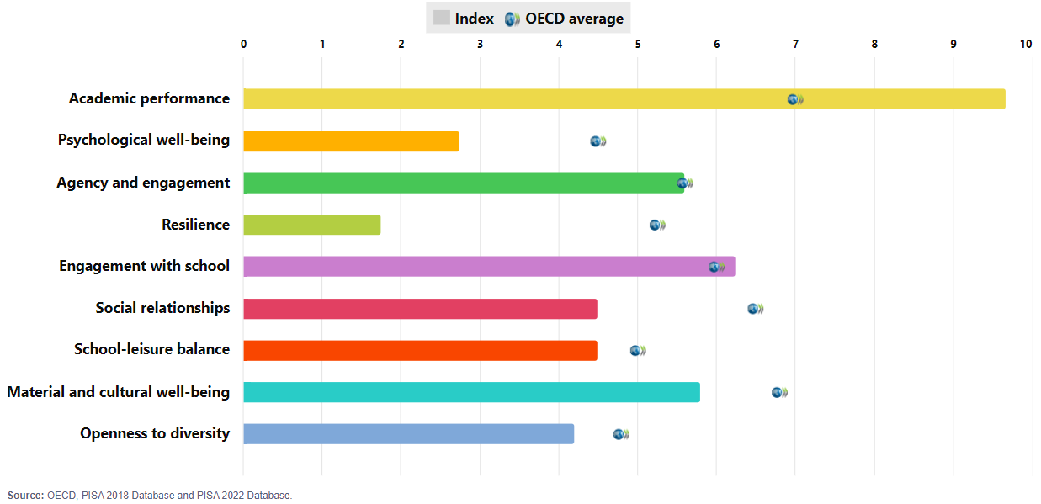
PISA 2022 outcomes: Hong Kong (China)

Slide 31
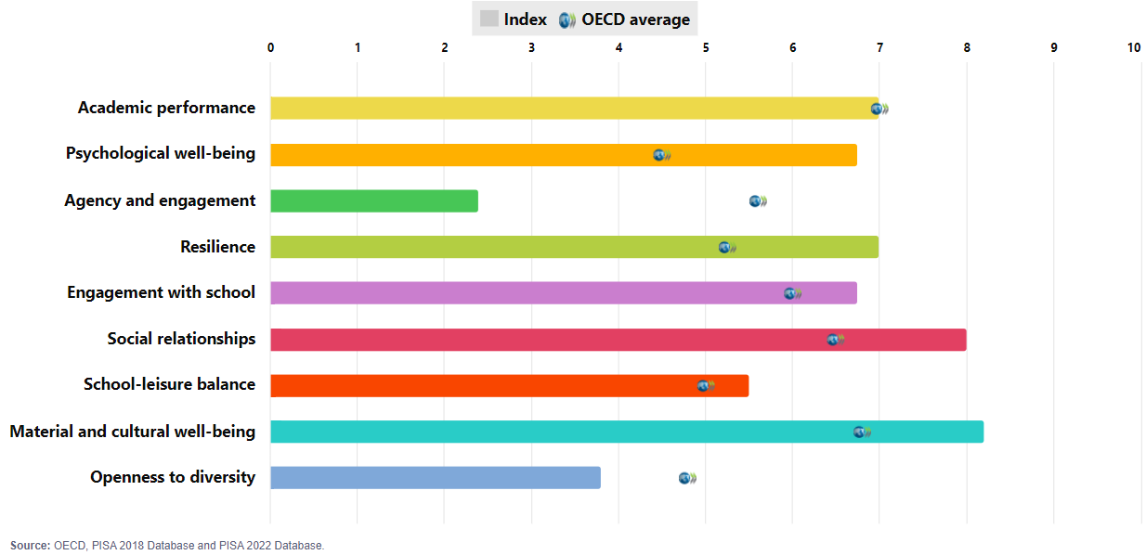
PISA 2022 outcomes: Hungary

Slide 32
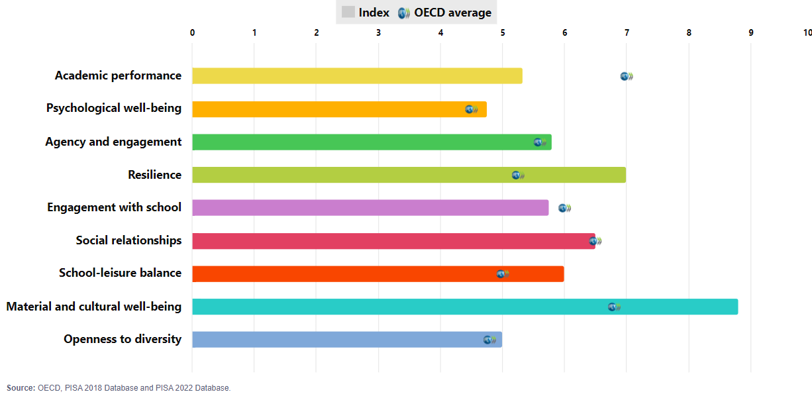
PISA 2022 outcomes: Iceland

Slide 33
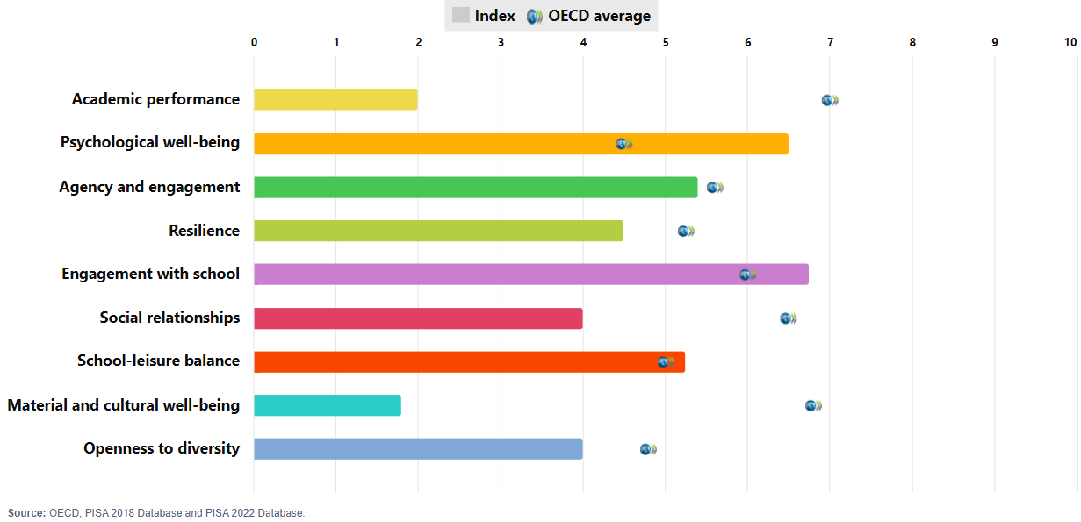
PISA 2022 outcomes: Indonesia

Slide 34
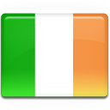
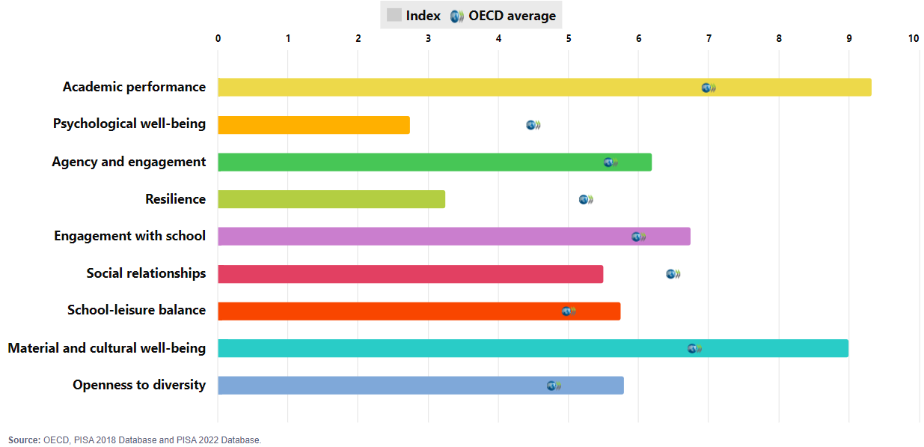
PISA 2022 outcomes: Ireland

Slide 35
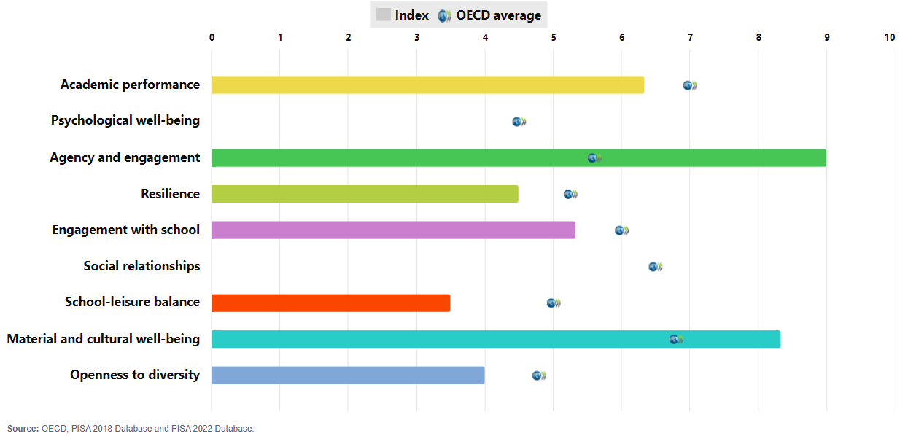
PISA 2022 outcomes: Israel

Slide 36
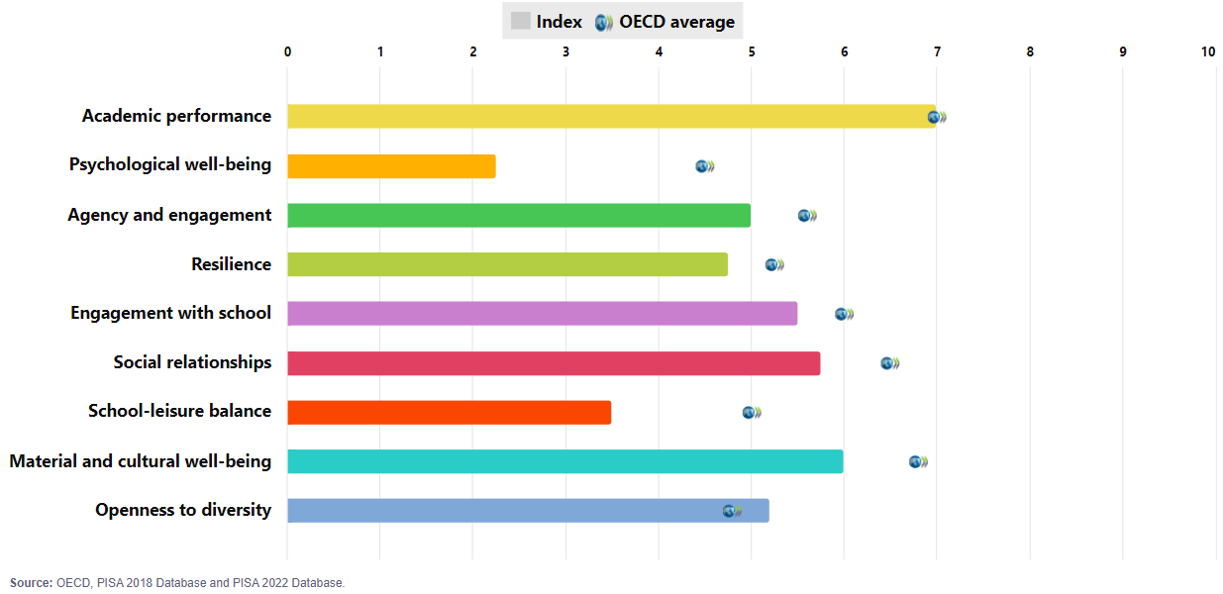
PISA 2022 outcomes: Italy

Slide 37
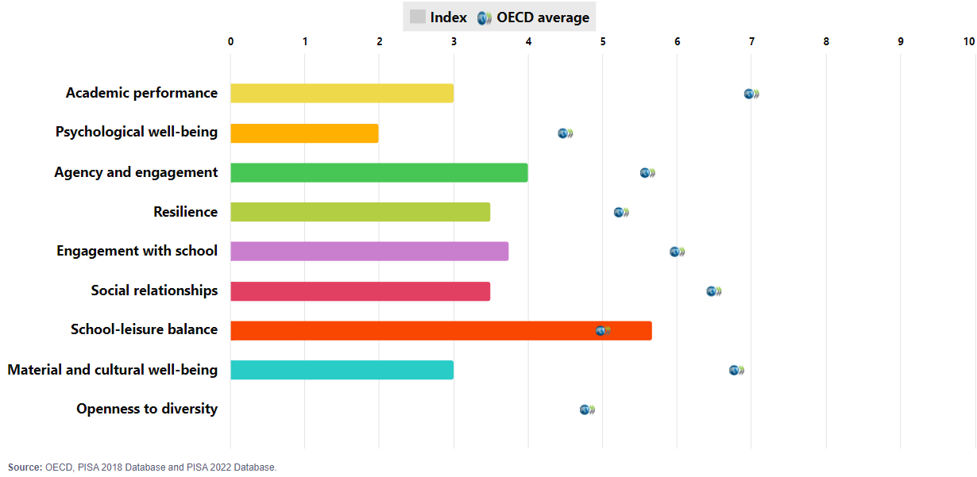
PISA 2022 outcomes: Jamaica

Slide 38
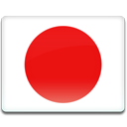
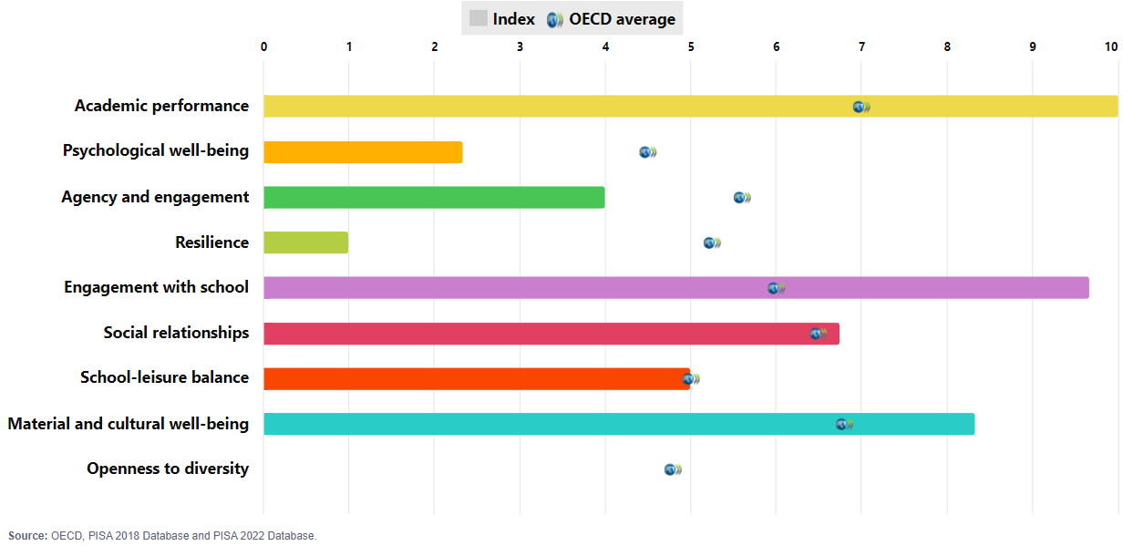
PISA 2022 outcomes: Japan

Slide 39
PISA 2022 outcomes: Japan

Slide 40
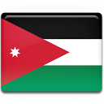
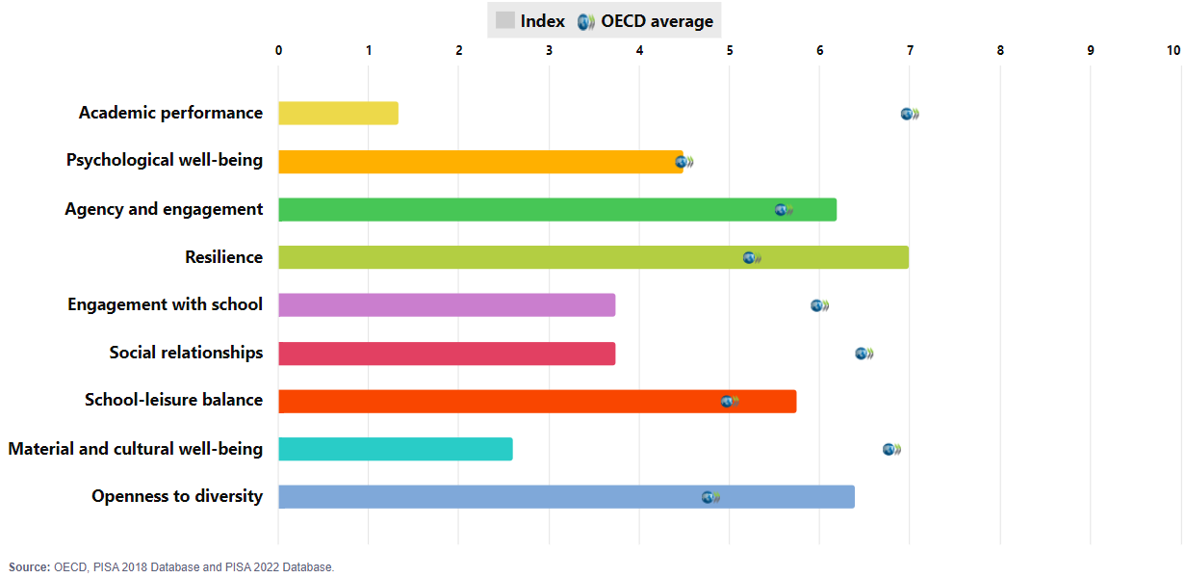
PISA 2022 outcomes: Jordan

Slide 41
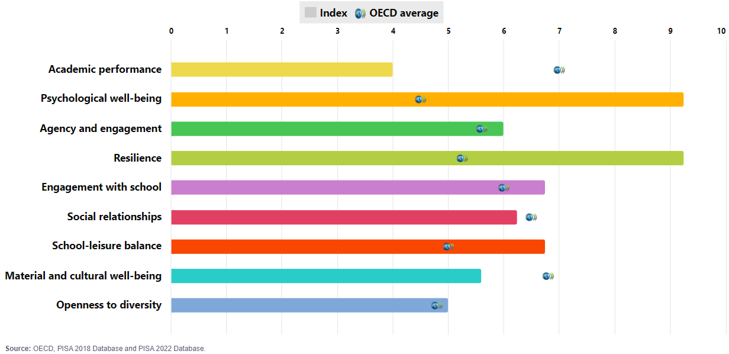
PISA 2022 outcomes: Kazakhstan

Slide 42
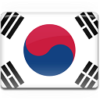
PISA 2022 outcomes: Korea

Slide 43
PISA 2022 outcomes: Kosovo

Slide 44
PISA 2022 outcomes: Latvia

Slide 45
PISA 2022 outcomes: Lithuania

Slide 46
PISA 2022 outcomes: Macao (China)

Slide 47
PISA 2022 outcomes: Malaysia

Slide 48
PISA 2022 outcomes: Malta

Slide 49
PISA 2022 outcomes: Mexico

Slide 50
PISA 2022 outcomes: Moldova

Slide 51
PISA 2022 outcomes: Mongolia

Slide 52
PISA 2022 outcomes: Montenegro

Slide 53
PISA 2022 outcomes: Morocco

Slide 54
PISA 2022 outcomes: Netherlands

Slide 55
PISA 2022 outcomes: New Zealand

Slide 56
PISA 2022 outcomes: North Macedonia

Slide 57
PISA 2022 outcomes: Norway

Slide 58
PISA 2022 outcomes: Palestinian Authority

Slide 59
PISA 2022 outcomes: Panama

Slide 60
PISA 2022 outcomes: Paraguay

Slide 61
PISA 2022 outcomes: Peru

Slide 62
PISA 2022 outcomes: Philippines

Slide 63
PISA 2022 outcomes: Poland

Slide 64
PISA 2022 outcomes: Portugal

Slide 65
PISA 2022 outcomes: Qatar

Slide 66
PISA 2022 outcomes: Romania

Slide 67
PISA 2022 outcomes: Saudi Arabia

Slide 68
PISA 2022 outcomes: Serbia

Slide 69
PISA 2022 outcomes: Singapore

Slide 70
PISA 2022 outcomes: Slovakia

Slide 71
PISA 2022 outcomes: Slovenia

Slide 72
PISA 2022 outcomes: Spain

Slide 73
PISA 2022 outcomes: Sweden

Slide 74
PISA 2022 outcomes: Switzerland

Slide 75
PISA 2022 outcomes: Thailand

Slide 76
PISA 2022 outcomes: Türkiye

Slide 77
PISA 2022 outcomes: Ukrainian regions (18 of 27)

Slide 78
PISA 2022 outcomes: United Arab Emirates

Slide 79
PISA 2022 outcomes: United Kingdom

Slide 80
PISA 2022 outcomes: United States

Slide 81
PISA 2022 outcomes: Uruguay

Slide 82
PISA 2022 outcomes: Uzbekistan

Slide 83
PISA 2022 outcomes: Viet Nam

